Slide 1
DevSecOps for Cloud Native Development on IBM Z Rosalind Radcliffe IBM Distinguished Engineer DevOps for Enterprise Systems

Slide 2



Delivering a Cloud Native Developer Experience on IBM Z
Containerization
Enterprise DevOps
Self-service provisioning
Shift-left operations
THE
VISION
For IBM Z to be a vibrant choice of platform in a hybrid multi-cloud world
THE
MISSION
To provide a cloud native developer experience for IBM Z that is consistent and familiar to all developers
Notes:
Hybrid multicloud
Integrate z/OS into a hybrid multi-cloud architecture powered by market leading development and management solutions
Self-service provisioning
Empower development squads to self provision z/OS runtimes and databases that support their applications and data
Enterprise DevOps
Deliver solutions with confidence through a fully integrated enterprise CI/CD pipeline embracing open source
Shift-left operations
Act on intelligent, operational feedback available from development to production based on variations in system behavior

Slide 3
LEGEND
Analyze
Feedback, approvals
Note: Starting from the upper left, products and significant capabilities appear once, the first time they are used in the pipeline. Products and capabilities are used at multiple points.
+
Code
Build
Provision
Deploy
Test
CI/CD Pipeline
Analyze
Plan
Monitor
Release

Slide 4



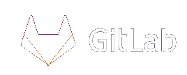
End to end cloud native developer experience
IBM Wazi for Red Hat CodeReady Workspaces
Add on to Cloud Pak for Applications
Code
Sandbox
Develop hybrid applications spanning IBM Z and multi cloud platforms using a standard DevOps toolchain
Portable across any cloud or platform. Optimized to run on Red Hat OpenShift
Reduce the need for specialized skills and improve productivity with cloud native tools
Bring your own IDE
Reduce costs with an enterprise wide standard toolchain
VS Code
Eclipse Che
Eclipse
Increase speed and agility with a containerized dev & test environment
Built upon open and familiar tools
Flexibility to re-balance entitlement over time; from what you need today, to what you need tomorrow

Slide 5
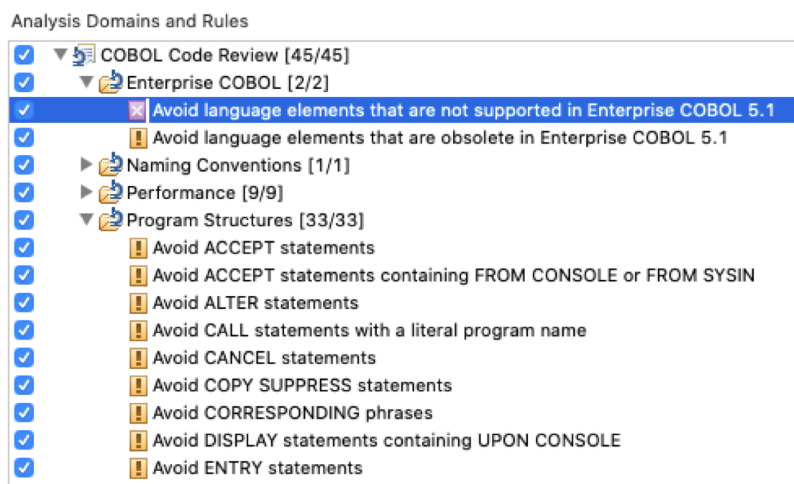
Static Code Analysis In IDEs
VSCode plugin
CodeSweep
IDz Code Analysis Rules

Slide 6
SQL Injection
CWE – 89 : https://cwe.mitre.org/data/definitions/89.html
Exposure:
Dynamic SQL commands like Prepare and Execute Immediately makes the application vulnerable to SQL injection attacks
EXEC SQL PREPARE SEL INTO :SQLDA FROM :STMTBUF END-EXEC.
STRING "INSERT INTO TBL (a, b, c) VALUES ("X ", " Y ", " Z ")" INTO MY-SQL.
EXEC SQL PREPARE MYSTMT FROM :MY-SQL END-EXEC.
EXEC SQL EXECUTE MYSTMT END-EXEC.
Types of SQL Injection:
Stack queries: SELECT name from PRODUCTS where productid = ‘p234’ ; DROP table CUTOMERS;
Hidden data: SELECT from CUSTOMERS where custid = ‘c732’ OR 1=1
Union injection: SELECT name, description from PRODUCTS where productid=‘p234’ UNION SELECT username, password FROM USERS
Fix:
STRING "INSERT INTO TBL (a, b, c) VALUES (?, ?, ?)" INTO WSQLSTMT.
EXEC SQL PREPARE MYSTMT FROM :WSQLSTMT END-EXEC.
EXEC SQL EXECUTE MYSTMT USING :X, :Y, :Z END-EXEC.
Convert SQL dynamic clauses into prepared statements

Slide 7

IBM Wazi Virtual Test Platform
Shift left application integration testing
IBM Wazi Virtual Test Platform transforms testing on Z by shifting left Application Integration testing as part of software development lifecycle
Moves application Integration Testing to earlier in the programming lifecycle.
Easy to deploy and use
Automates the testing process to enable an agile CI/CD pipeline.
No dependency on any z/OS
or client software
Automates regression testing after compiler upgrades, ABO implementation and SCM tool migrations.
An all new capability

Slide 8
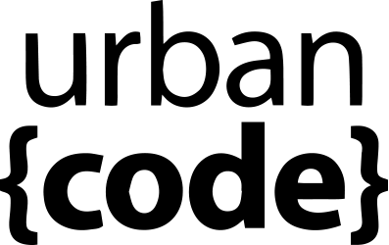


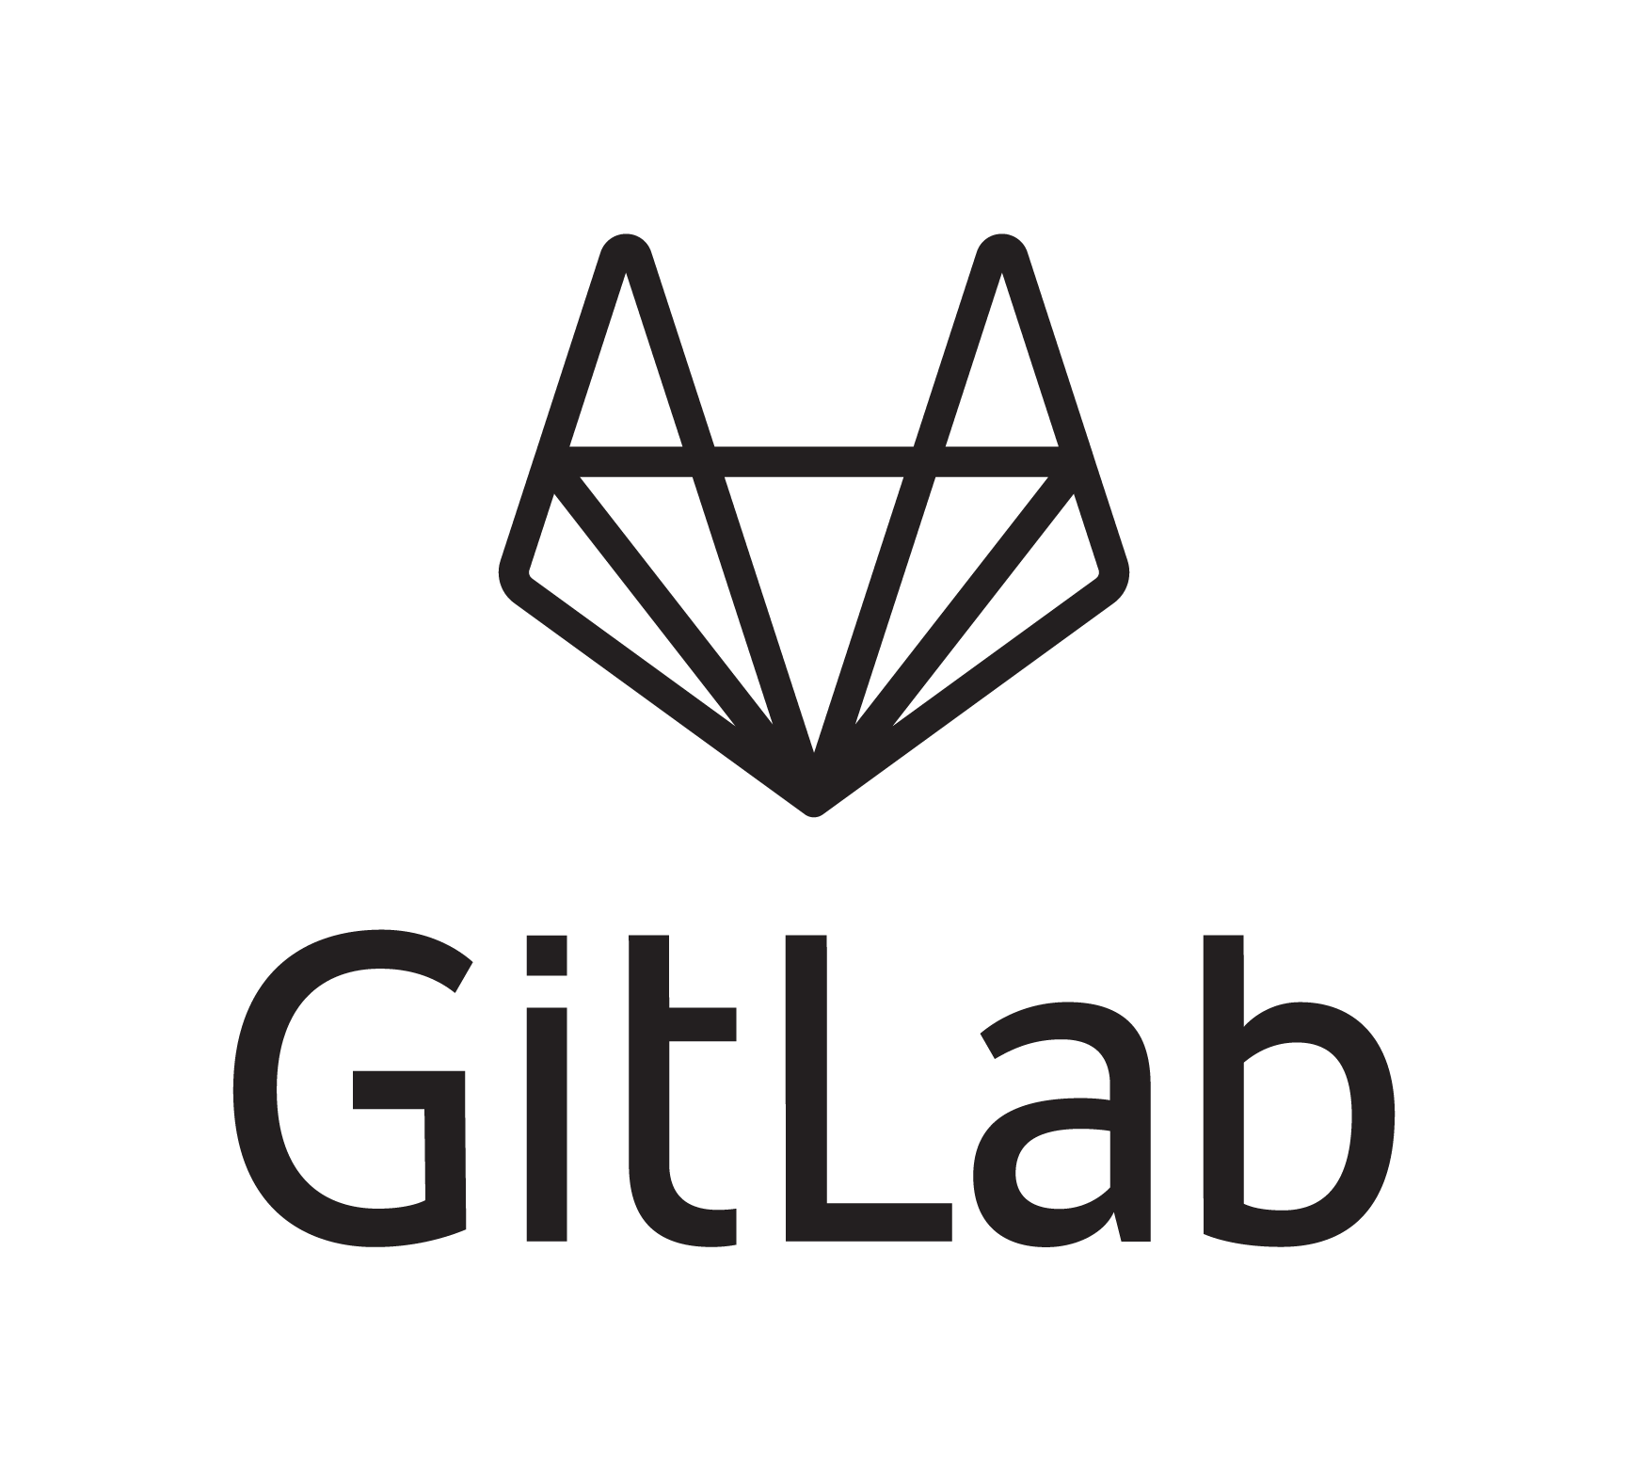













LEGEND
Eclipse, VS Code, Eclipse Che (BYOI) IBM Developer for z/OS Enterprise Edition (IDzEE)
IBM Wazi Workspaces (Code)
Dependency Base Build (IDzEE)
ZUnit (IDzEE)
IBM Wazi Virtual Test Platform
IBM Z Development and Test Enviroment (ZD&T)
IBM Wazi Workspaces (Sandbox)
IBM z/OS Cloudbroker
IBM Optim Test Data Managament
IBM Rational Test Workbench
Analyze
Feedback, approvals
uBuild AppScan
Note: Starting from the upper left, products and significant capabilities appear once, the first time they are used in the pipeline. Products and capabilities are used at multiple points.
https://galasa.dev/
+
Code
Build
Provision
Deploy
Test
CI/CD Pipeline
Nexus
Analyze
Plan
Monitor
Release
IBM Application
Discovery and Delivery
Intelligence
IBM Engineering Workflow Management
IBM Z APM Connect
OMEGAMON
Operational Insights

Slide 9
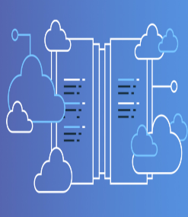
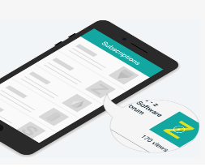
Resources
IBM Wazi for Red Hat® CodeReady Workspaces
The Open Developer experience for the mainframe demo
IBM Wazi VTP Expert Blog
IBM zDevOps
IBM Wazi VTP Demo
IBM Marketplace
www.ibm.com/products/wazi-for-red-hat-codeready-workspaces
All you need to know about Enterprise DevOps: case studies, communities, resource library, product list, education and much more
https://www.ibm.com/it-infrastructure/z/capabilities/enterprise-devops
A demo illustrating how to use CI/CD practices, common tools, and a collaborative coding environment to bridge the gap between mainframe and other platforms
https://www.youtube.com/watch?v=vRxdhlaRqA0&feature=youtu.be
See Wazi VTP in action with this demo
https://mediacenter.ibm.com/media/t/1_tbcimobz
Expert blog
https://developer.ibm.com/mainframe/2020/05/27/ibm-wazi-virtual-test-platform/

